Slide 1
GEN AI DRIVEN HABITAT RESTORATION OF A SPECIFIC REGION (Madagascar)
SUBMITTED BY: GUIDED BY:
K. LOGAVARSHINI T. VENKATESH
126179023 School of Electrical and
B.Tech-Robotics and Artificial Intelligence Electronics Engineering
SASTRA Deemed University,

Slide 2
INTRODUCTION
Ecosystems around the world are under pressure due to deforestation, climate change, and unsustainable land use.
Habitat restoration is critical for biodiversity conservation, carbon sequestration and sustainable development.
Generative AI (GenAI) can offer data-driven insights and simulate restoration scenarios with high spatial precision.

Slide 3
MOTIVATION
Scalability & automation: Manual restoration planning is slow and resource-intensive.
GenAI opportunity: Recent advances in GANs and image-to-image translation can help generate restoration maps from degraded inputs using learned patterns.

Slide 4
OBJECTIVE
To develop a GenAI-based framework for habitat restoration using multi-channel geospatial data.
Use Pix2Pix GAN architecture to learn relationships between environmental indicators and restoration targets.

Slide 5
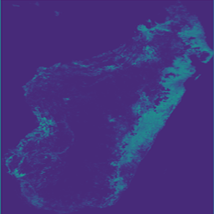
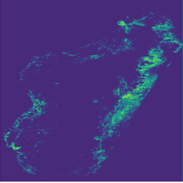
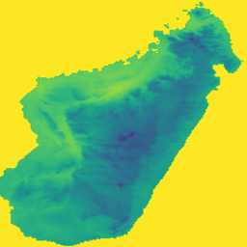
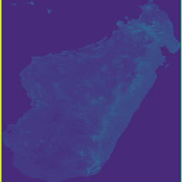
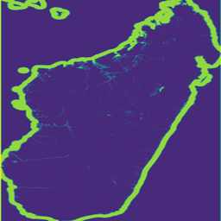
DATASETS
5 DATASETS FROM GOOGLE EARTH ENGINE
FOREST LOSS
LAND COVER LOSS
MEAN TEMPERATURE
SOIL CARBON
WATER OCCURRENCE

Slide 6
DATASET PAIRS
The dataset pairs are paired into 3 pairs. They are divided as Input → Target
Land_cover_loss.png → Forest_loss.png
Goal: Predict forest degradation based on changes in land cover.
Soil_carbon.png → Water_occurrence.png
Goal: Predict water-related degradation from soil carbon patterns.
Mean_temperature.png → Forest_loss.png
Goal: Predict forest degradation based on temperature anomalies. The dataset pairs were chosen to explore causal or correlational relationships between environmental factors (inputs) and their ecological impacts (targets). By training GenAI models on these pairs, the goal is to predict key habitat degradation indicators from related environmental variables, enabling more informed and data-driven habitat restoration planning.

Slide 7
PROJECT OVERVIEW
The datasets are sliced into 16 individual pixels.
The 16 pixels are trained using Pix2Pix GAN.
After training, the 16 pixels are stitched to form a full region map.
Stitching leads to the formation of gridlines across the map.
This gridlines can be reduced by using gen ai techniques like Conditional Diffusion Models.
Then the 3 outputs generated from the Conditional Diffusion are used to generate a restoration map using a U-Net neural network a supervised learning form of Convolution Neural Network.

Slide 8
STREAMLIT
An interactive Streamlit app to visualize dataset pairs, diffusion outputs, and restoration maps for habitat analysis is developed.
It also estimates and highlights restorable areas with automated overlay and percentage calculations for better decision-making

Slide 9
THANK YOU!!!

